Slide 1
Landscape Lighting Design
Comprehensive Guide to Lighting Techniques and Methods
Vince Bowers | MARKETING MANAGER
Notes:
Introduction to comprehensive lighting design techniques for enhancing outdoor spaces, presented by the Alliance Outdoor Lighting team.

Slide 2
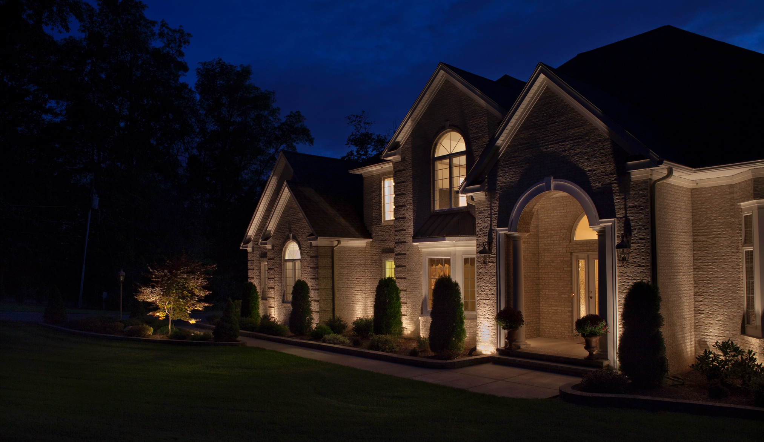
Introduction to
Landscape Lighting Design
Enhance outdoor spaces with safety, beauty, and functionality.
Notes:
Landscape lighting design not only beautifies spaces but also adds a layer of safety and security. This presentation covers key techniques and methods.

Slide 3
Benefits of Landscape Lighting
Security: Deter potential intruders
Safety: Prevent
accidents in dark areas
Visual appeal: Showcase landscaping and architecture
Notes:
The three main benefits: aesthetic enhancement, added safety, and increased security. Lighting can transform outdoor spaces and deter unwanted activity.

Slide 4
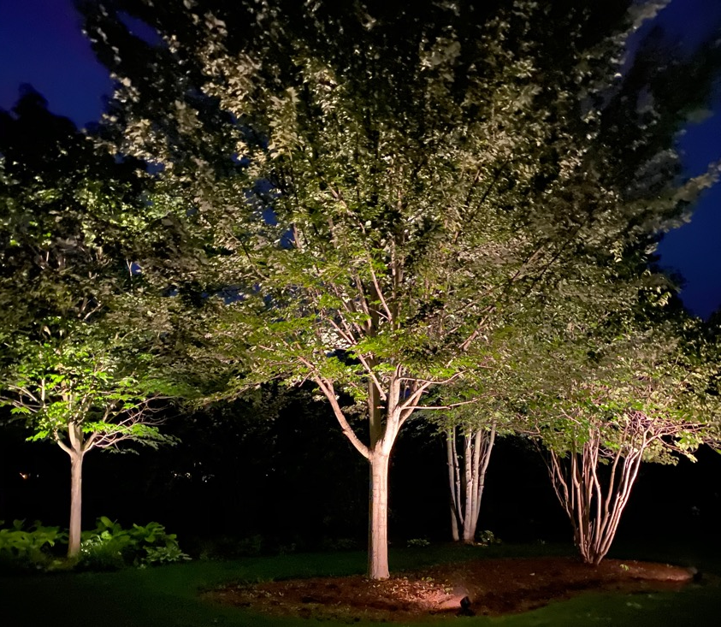
Basics of Lighting Design
Types of lighting: ambient, accent, and task lighting
Focal points, layering and balance
Notes:
Basics of design include creating focal points, layering light sources, and balancing illumination. Covers types of lighting: ambient, accent, and task.

Slide 5
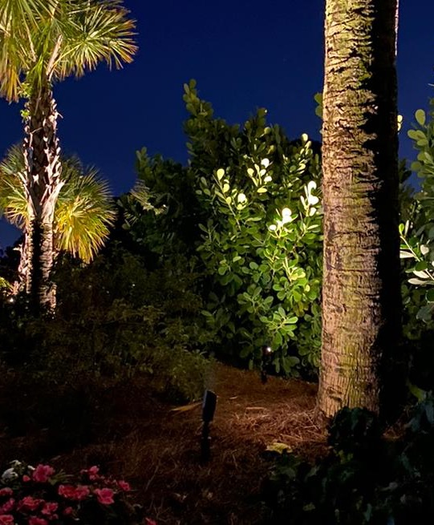
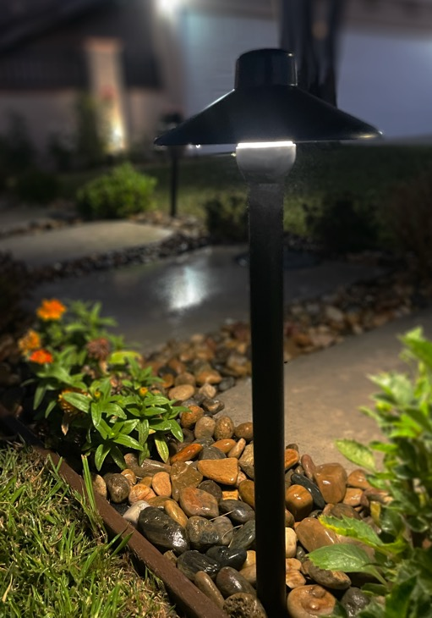
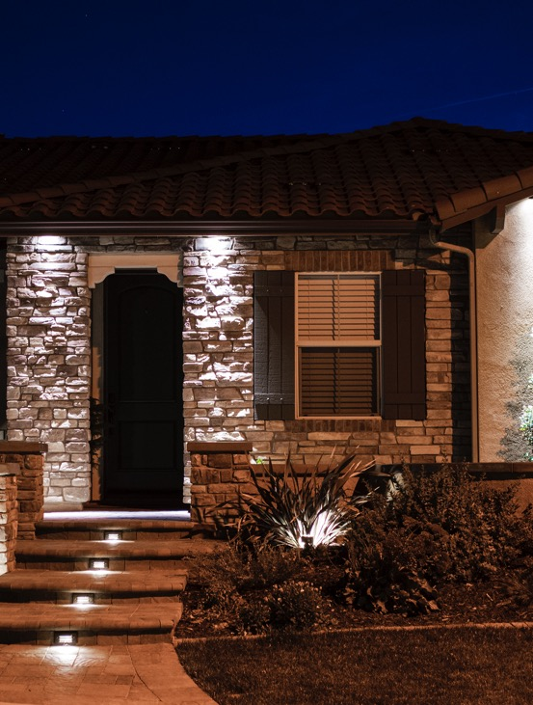
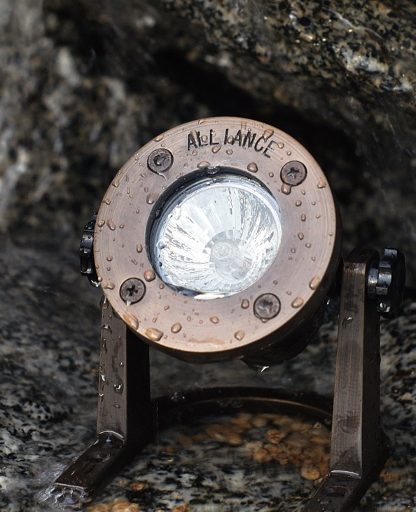
Common Landscape Lighting Techniques
Uplighting
Path Lighting
Downlighting
& More
Notes:
Brief overview of lighting techniques, such as path lighting and uplighting, used to achieve different effects in landscape design.

Slide 6
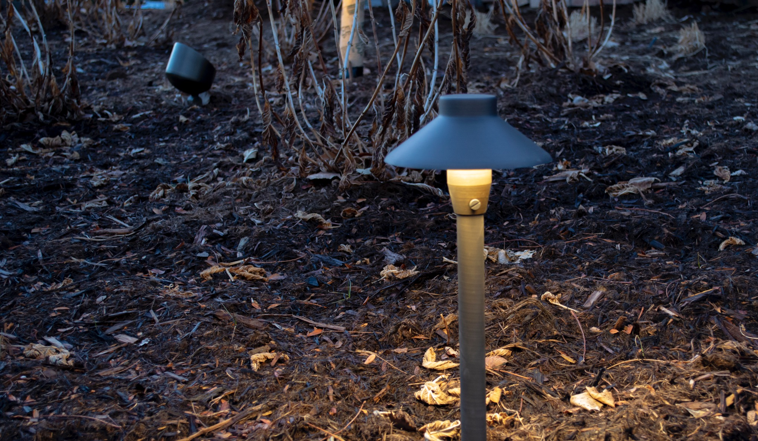
Path Lights
Purpose: Safe navigation, guiding pathways
Placement tips and fixture recommendations
Notes:
Path lighting is essential for safe navigation along walkways and paths. Discuss placement tips and appropriate fixtures for guiding pathways.

Slide 7
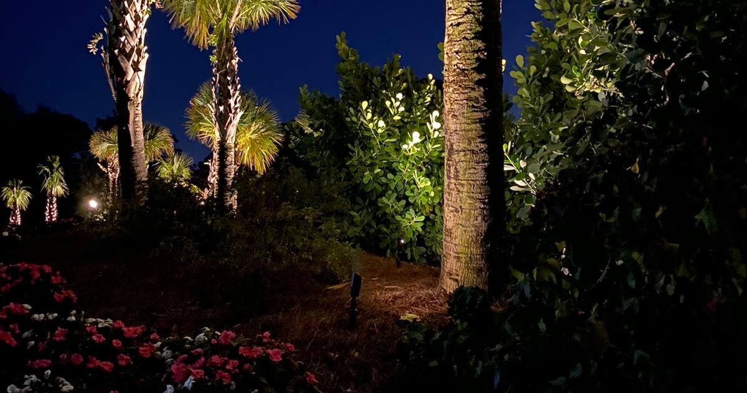
Uplighting
Purpose: Highlight trees, architecture, or structures
Techniques for various effects
Notes:
Uplighting is used to emphasize trees and structures from below. Effective for highlighting tall objects or focal points in the landscape.

Slide 8
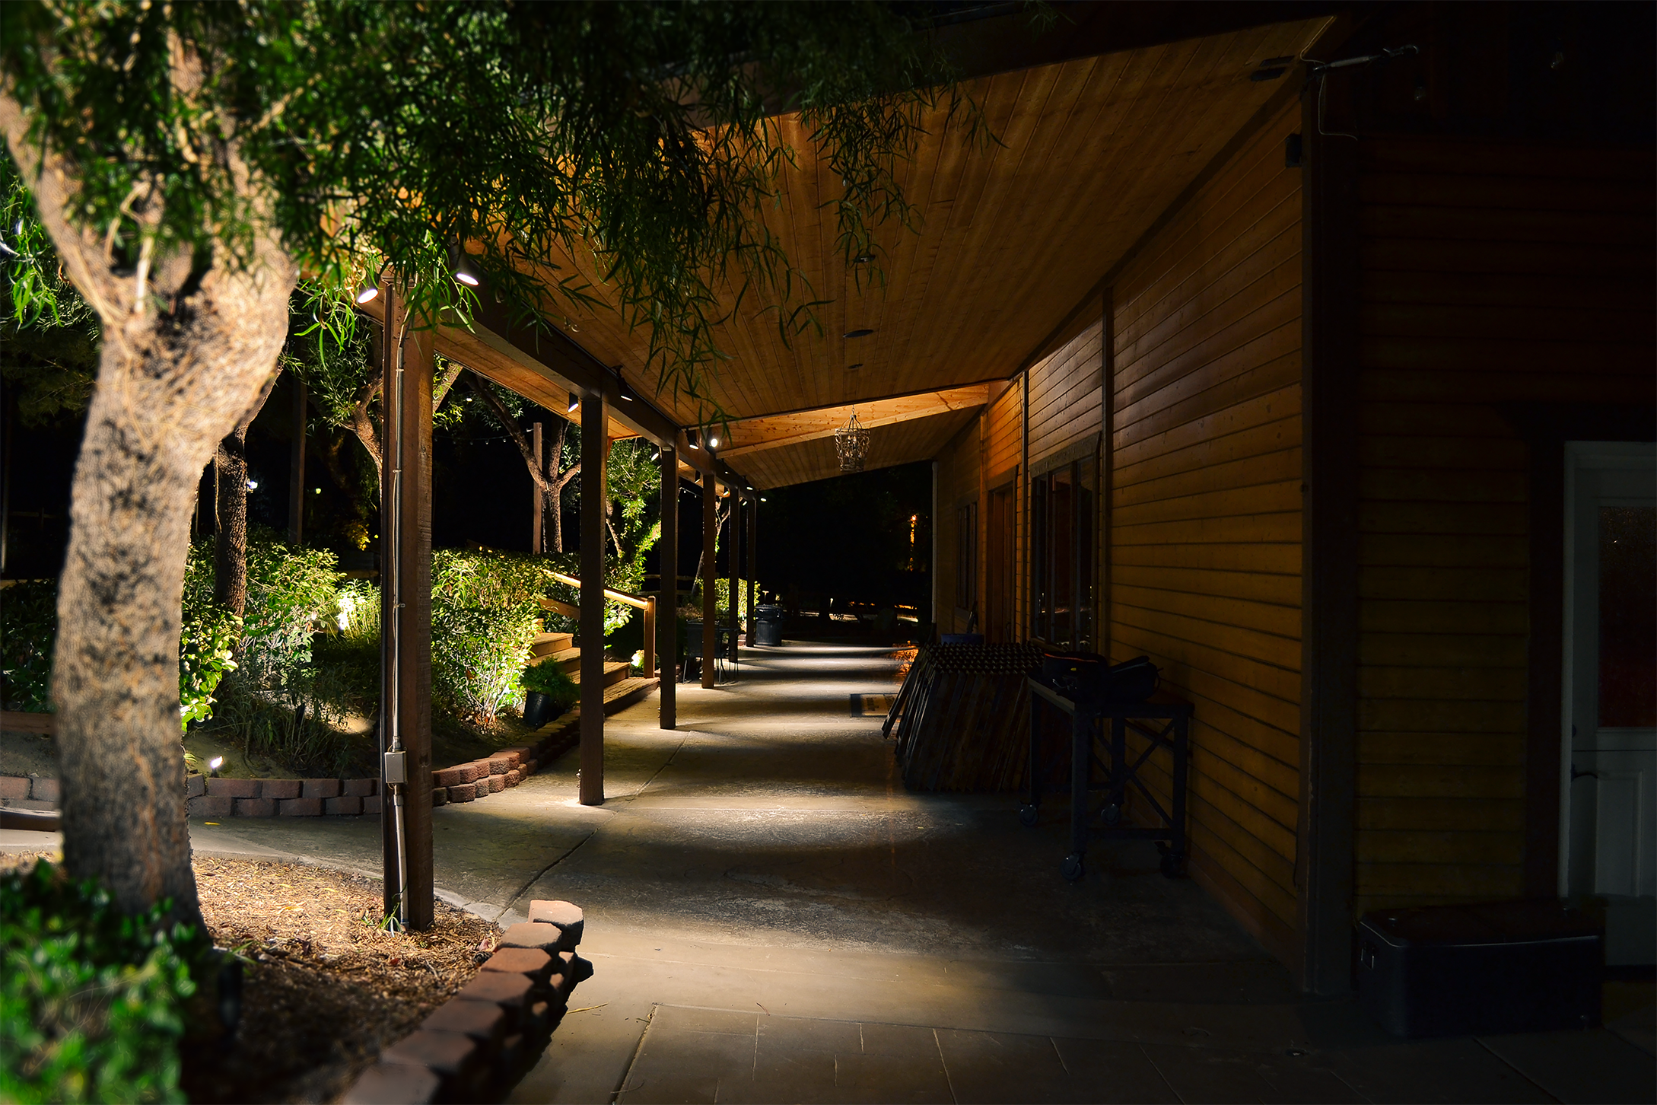
Downlights
Purpose: Create a natural 'moonlight' effect from above
Ideal for highlighting garden beds, patios, and seating areas
Notes:
Downlighting mimics natural moonlight by illuminating areas from above, perfect for garden beds and creating a softer ambiance.

Slide 9
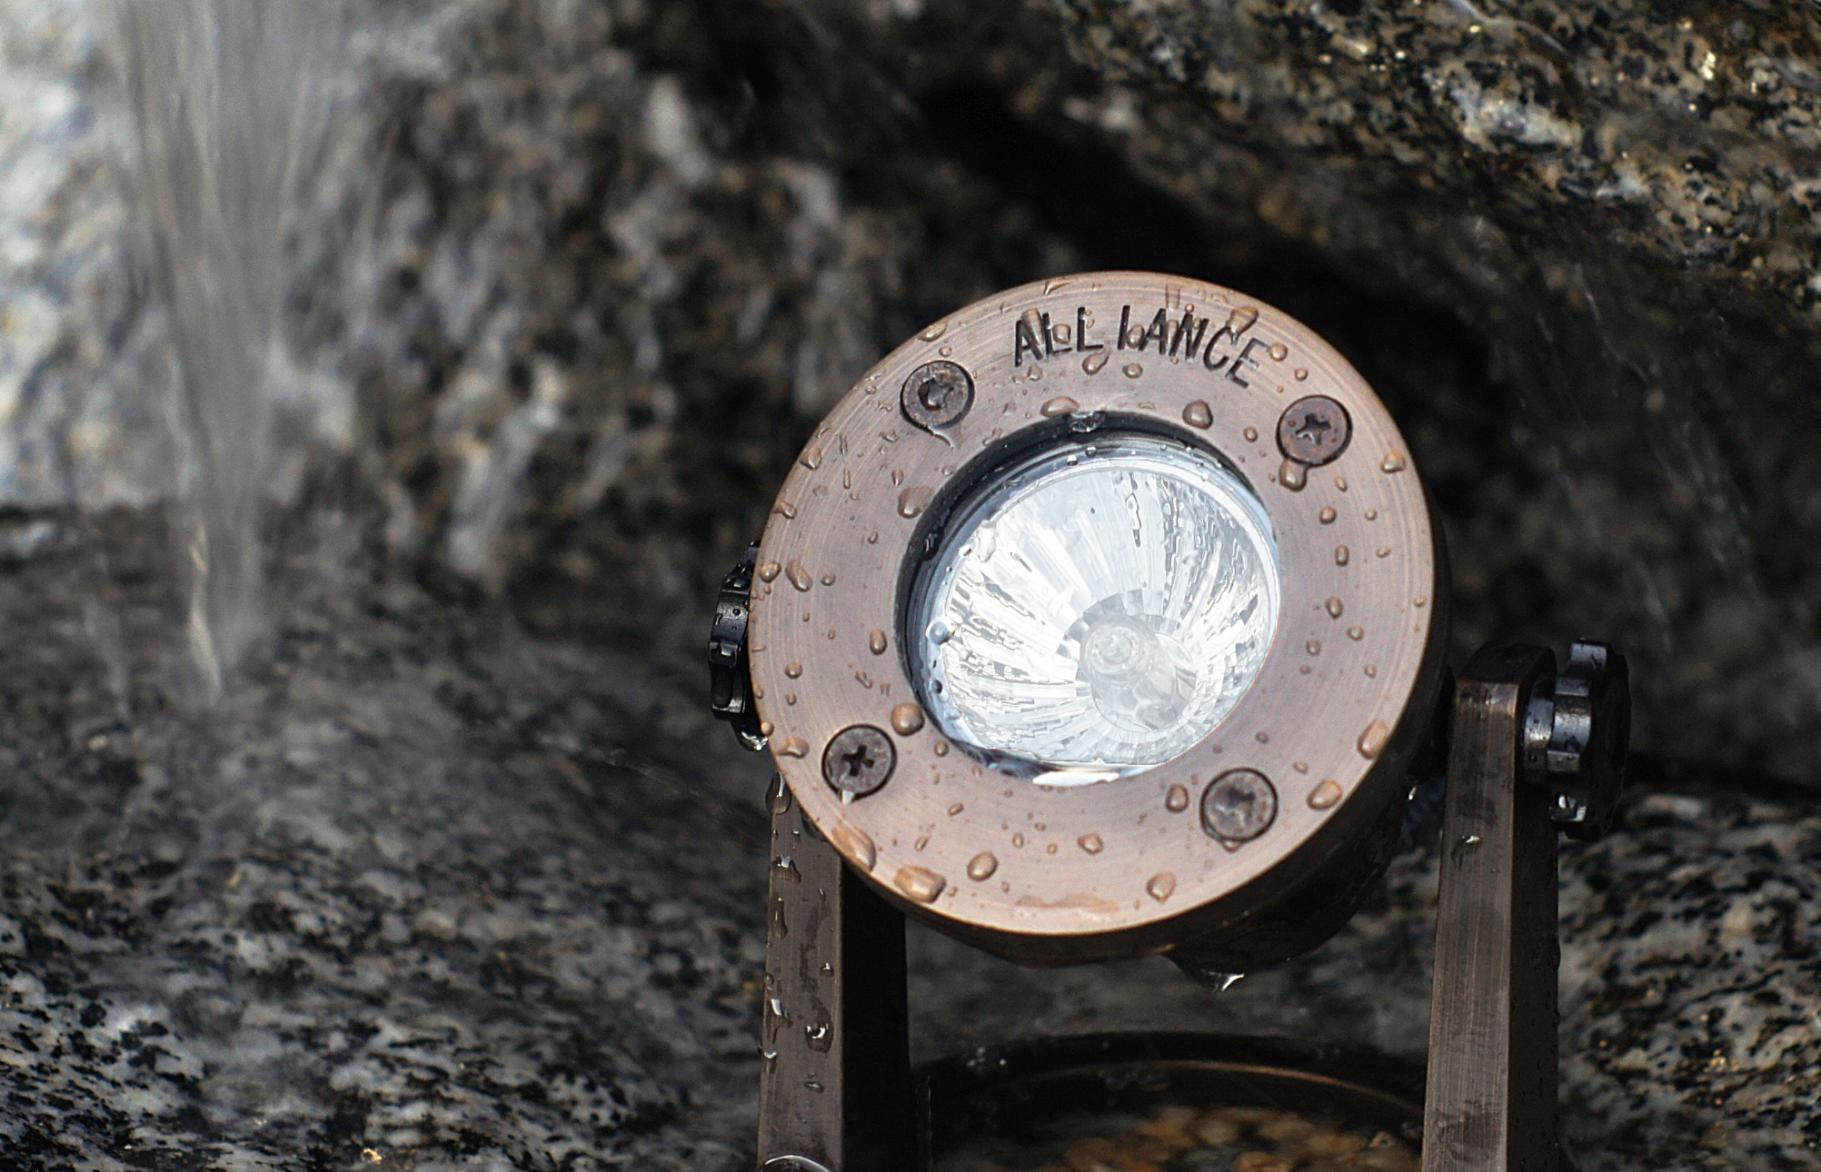
Specialty Lighting
Techniques
Underwater lighting, deck lighting, step lighting
Tips for enhancing unique features in the landscape
Notes:
Covers specialty techniques like underwater, deck, and step lighting, which emphasize particular areas for added functionality and style.

Slide 10

Silhouetting
Purpose: Create drama by placing lights behind objects
Ideal for unique tree shapes, sculptures, or architectural details
Notes:
Silhouetting places light behind objects, like trees or sculptures, casting dramatic shadows for added depth and interest.

Slide 11
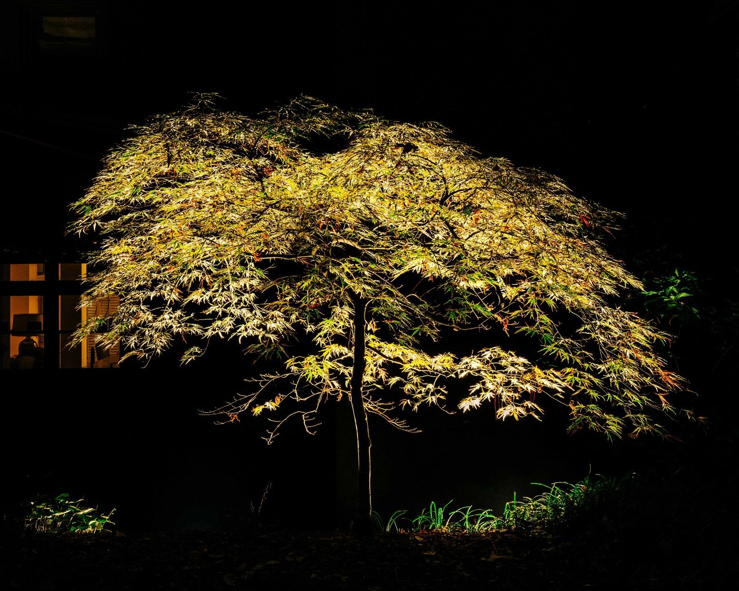

Slide 12

Shadowing
Purpose: Add depth by casting shadows on walls or structures
Recommended for creating a soft, natural ambiance
Notes:
Shadowing adds texture and depth, casting shadows against walls or objects. It helps create a softer, natural look in outdoor areas.

Slide 13
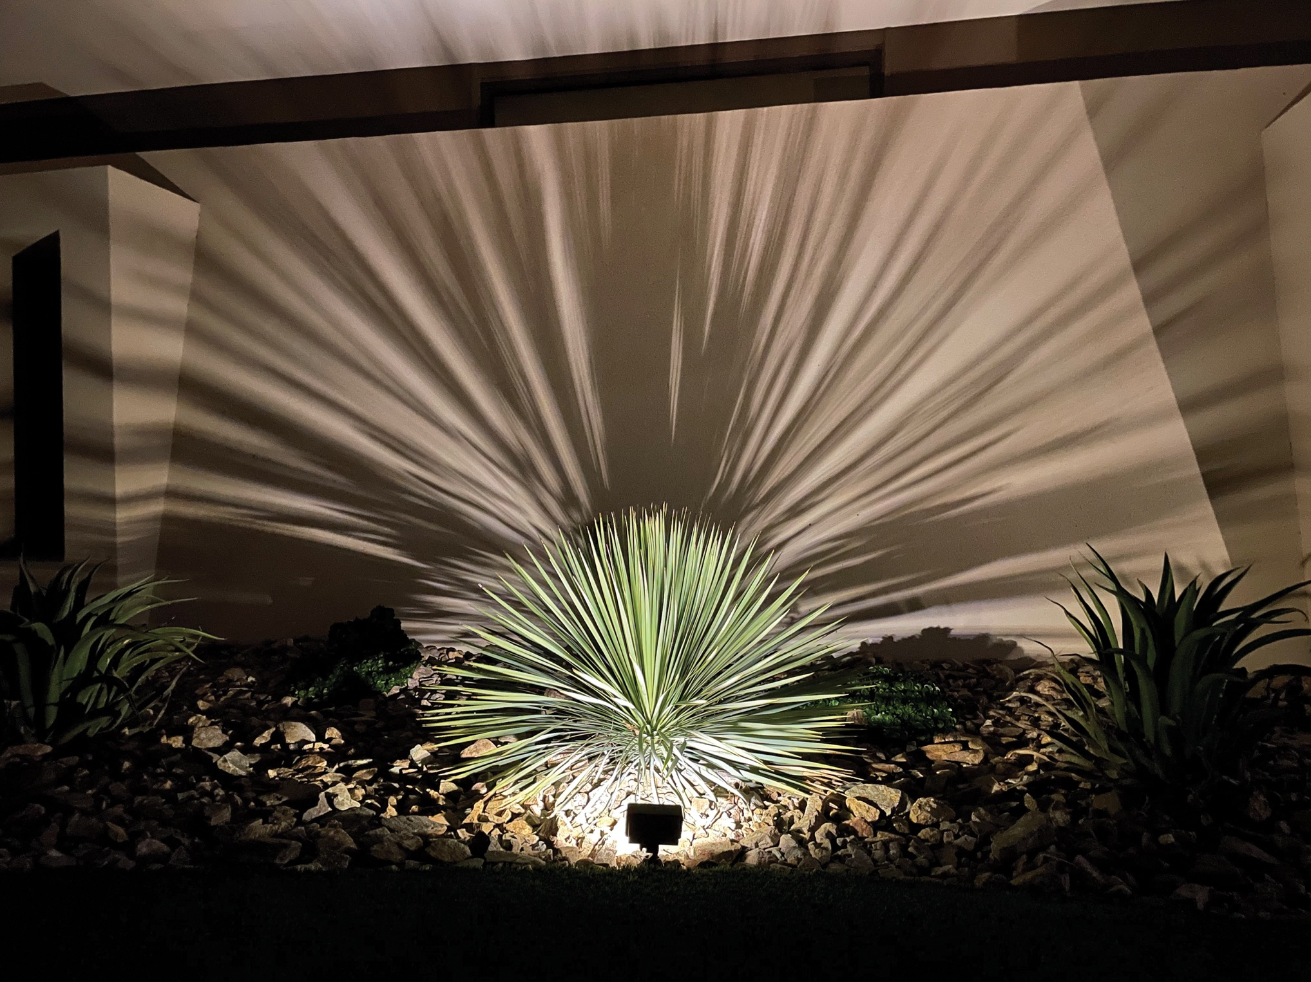

Slide 14

Wall Washing
Purpose: Evenly illuminate flat surfaces or walls
Tips for using wide-beam lights for soft illumination
Notes:
Wall washing uses wide-beam lights to evenly illuminate flat surfaces, often for highlighting architectural walls and garden beds.

Slide 15


Slide 16

Grazing
Purpose: Highlight textures (stone walls, trees, etc.)
Place lights close to textured surfaces for best results
Notes:
Grazing is a technique where lights are placed close to textured surfaces, highlighting their unique patterns, like stone walls or tree bark.

Slide 17
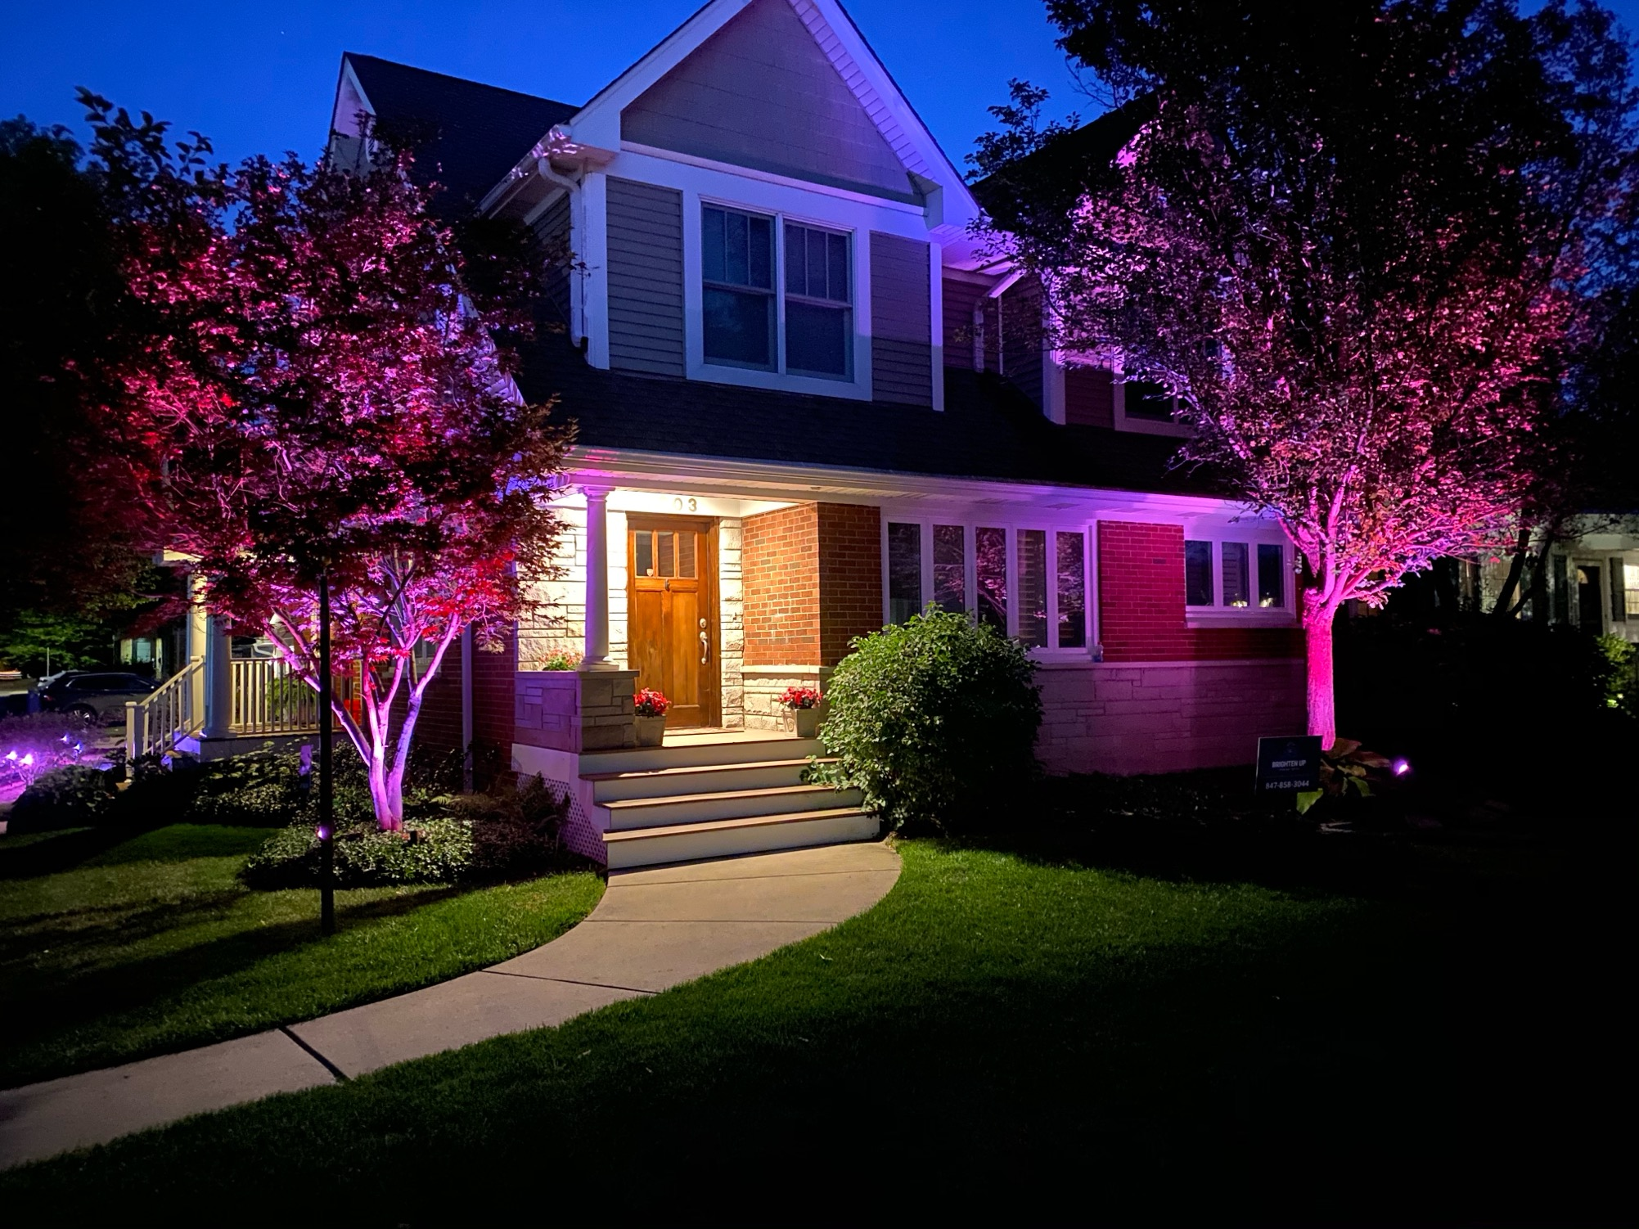

Slide 18

Mirror Lighting
Purpose: Enhance lighting effects with water reflections
Ideal for ponds, pools, and other water features
Notes:
Mirror lighting leverages water's reflective properties, like pools or ponds, to double the lighting effect and create visual interest.

Slide 19
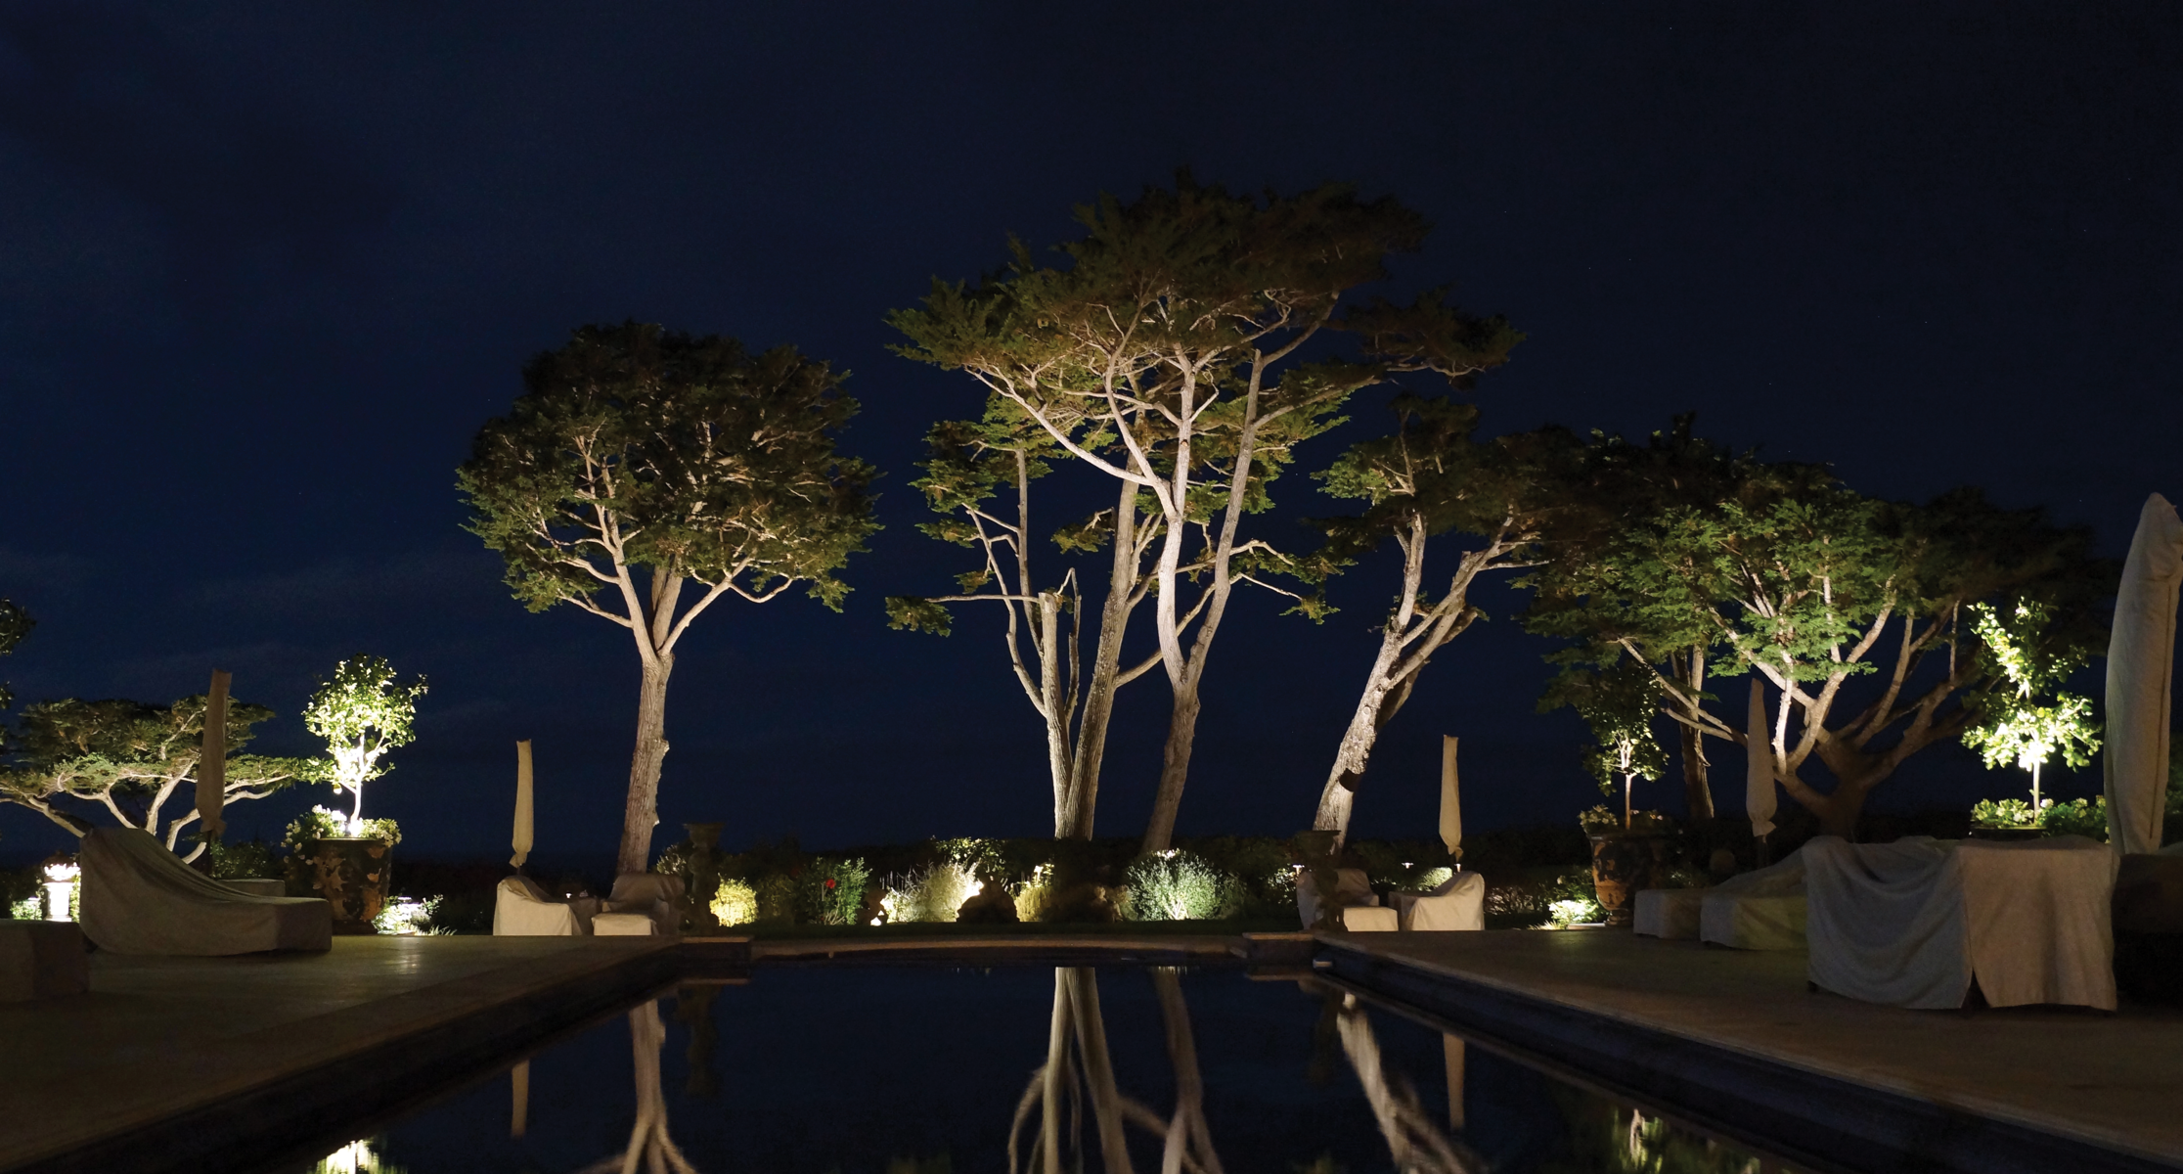

Slide 20
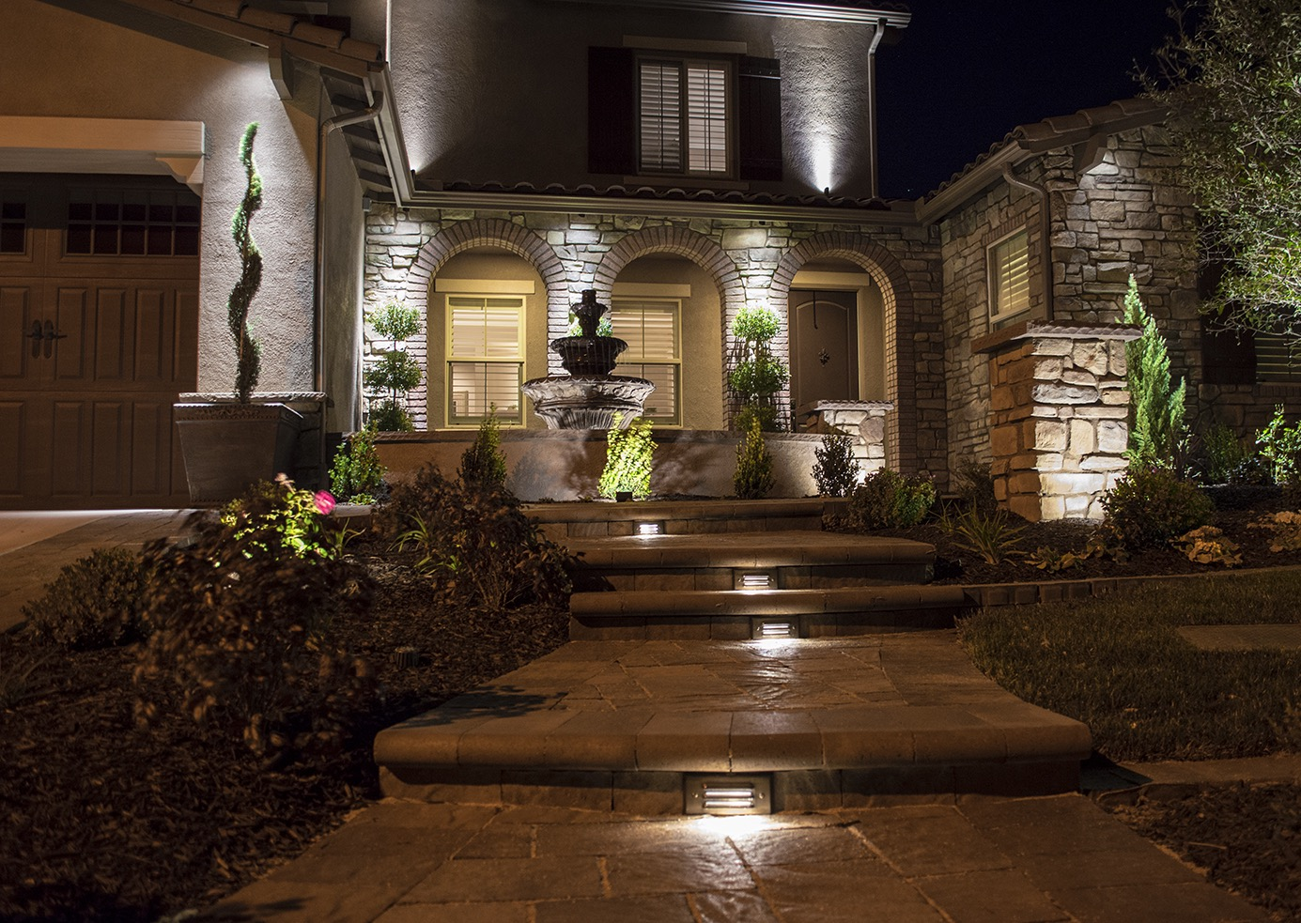

Creating Layers in
Lighting Design
Benefits of layering different light types
Examples: Combining path, accent, and ambient lighting
Notes:
Layering lights combines various types, such as path and accent lighting, to create a dynamic and balanced lighting scheme.

Slide 21
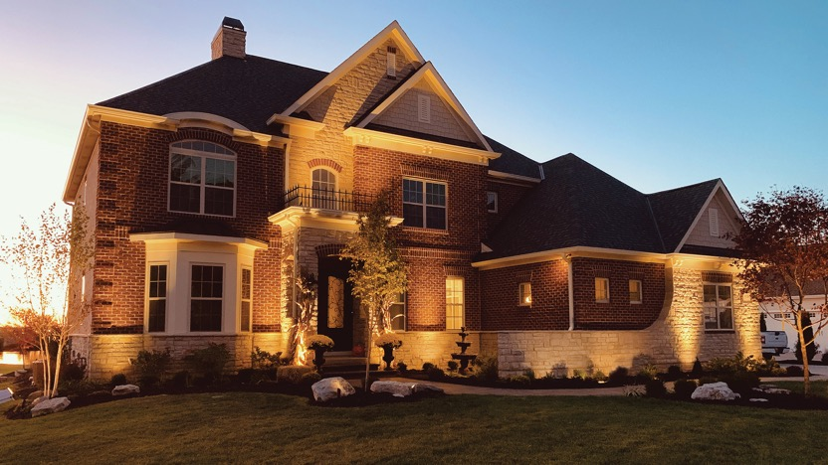
Choosing the Right Color Temperature
Warm vs. cool lighting effects
Recommendations based on desired atmosphere
Notes:
Selecting color temperature is crucial. Warm lighting offers a cozy feel, while cooler tones are better for security or modern looks.

Slide 22
Selecting the Right Beam Angles
Narrow vs. wide beam angles for specific effects
Tips for accentuating different landscape elements
Notes:
Beam angles impact the lighting effect. Narrow beams highlight specific details, while wide beams cover larger areas.

Slide 23
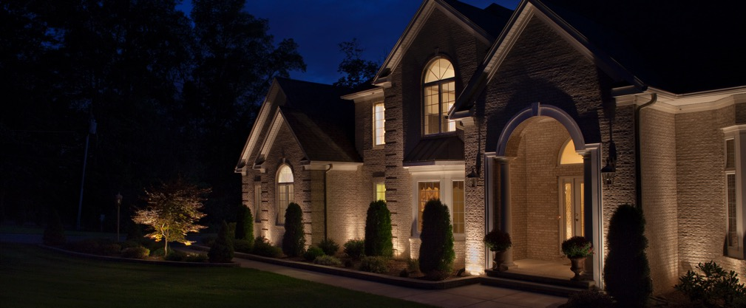
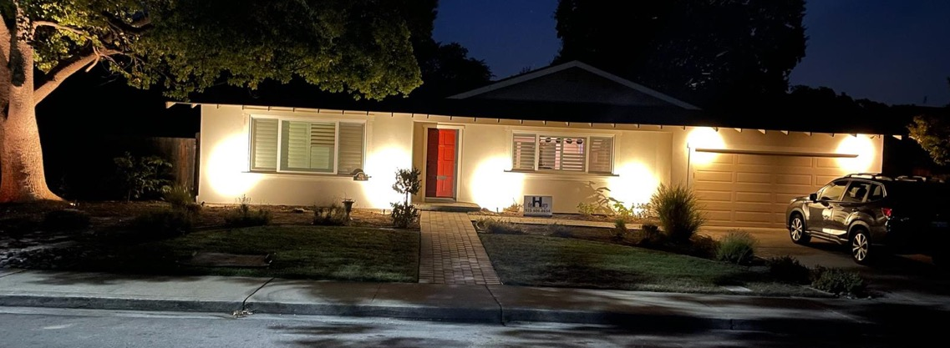
Tips for Balancing Light Levels
Avoid overly bright areas
Ensure even lighting distribution for a cohesive look
Notes:
Achieving balanced light prevents harsh spots. Ensuring even distribution makes the design cohesive and visually comfortable.

Slide 24
Landscape Lighting
Design Do's and Don’ts
Best practices for effective lighting design
Common pitfalls to avoid, such as over-lighting and glare
Notes:
Lists best practices and common mistakes to avoid in landscape lighting, including issues like glare and over-lighting.

Slide 25
Case Studies and Examples
Real-life examples of successful lighting designs
Notes:
Provides real-world case studies to illustrate the successful application of various lighting techniques.

Slide 26

Contact Information
Your Name
name@allianceoutdoorlighting.com
888-888-8888
Notes:
Open floor for audience questions and provide contact information for further queries or consultations.

Slide 27
THANK YOU

