Slide 1
NEW PRODUCTS
2025

Slide 2
HSC

Slide 3
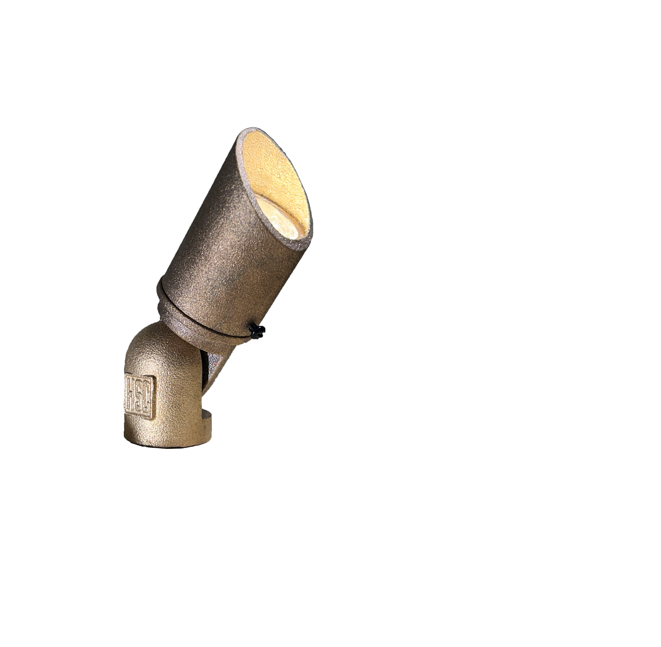
HSC-BL2
Heavy Sand-Cast Bronze
Adjustable shroud
Smaller bullet light

Slide 4
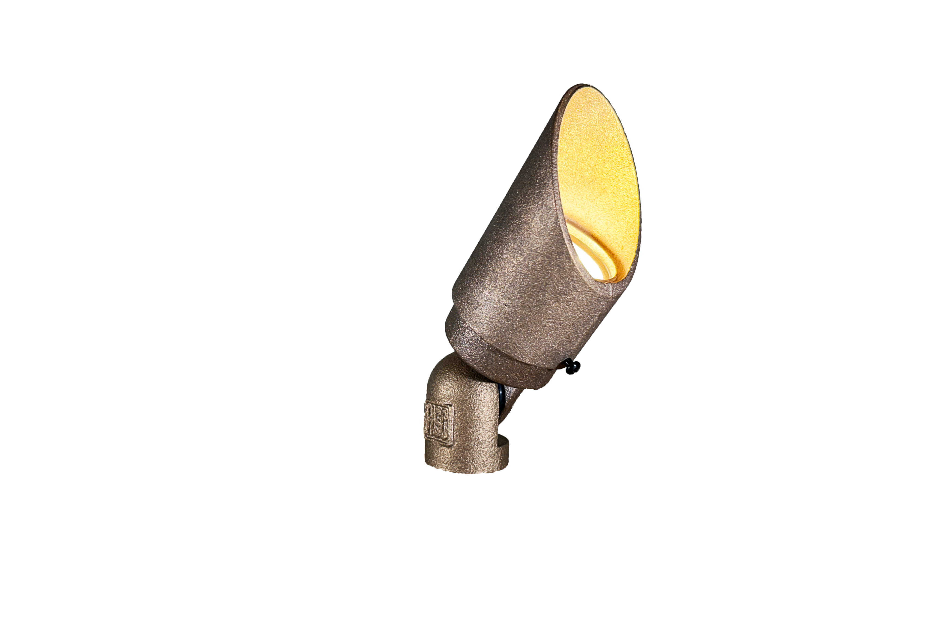
HSC-BL3-BT
Heavy Sand-Cast Bronze
Bluetooth fixture
Adjustable shroud

Slide 5
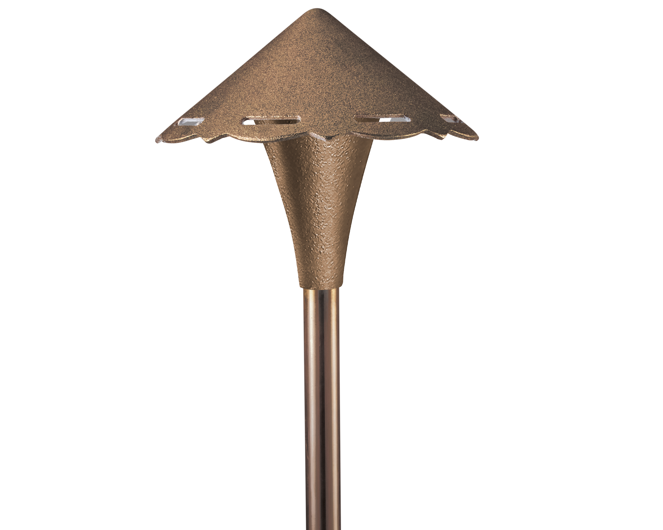
HSC-PL2
Heavy Sand-Cast Bronze
Patterned-cutout hat

Slide 6
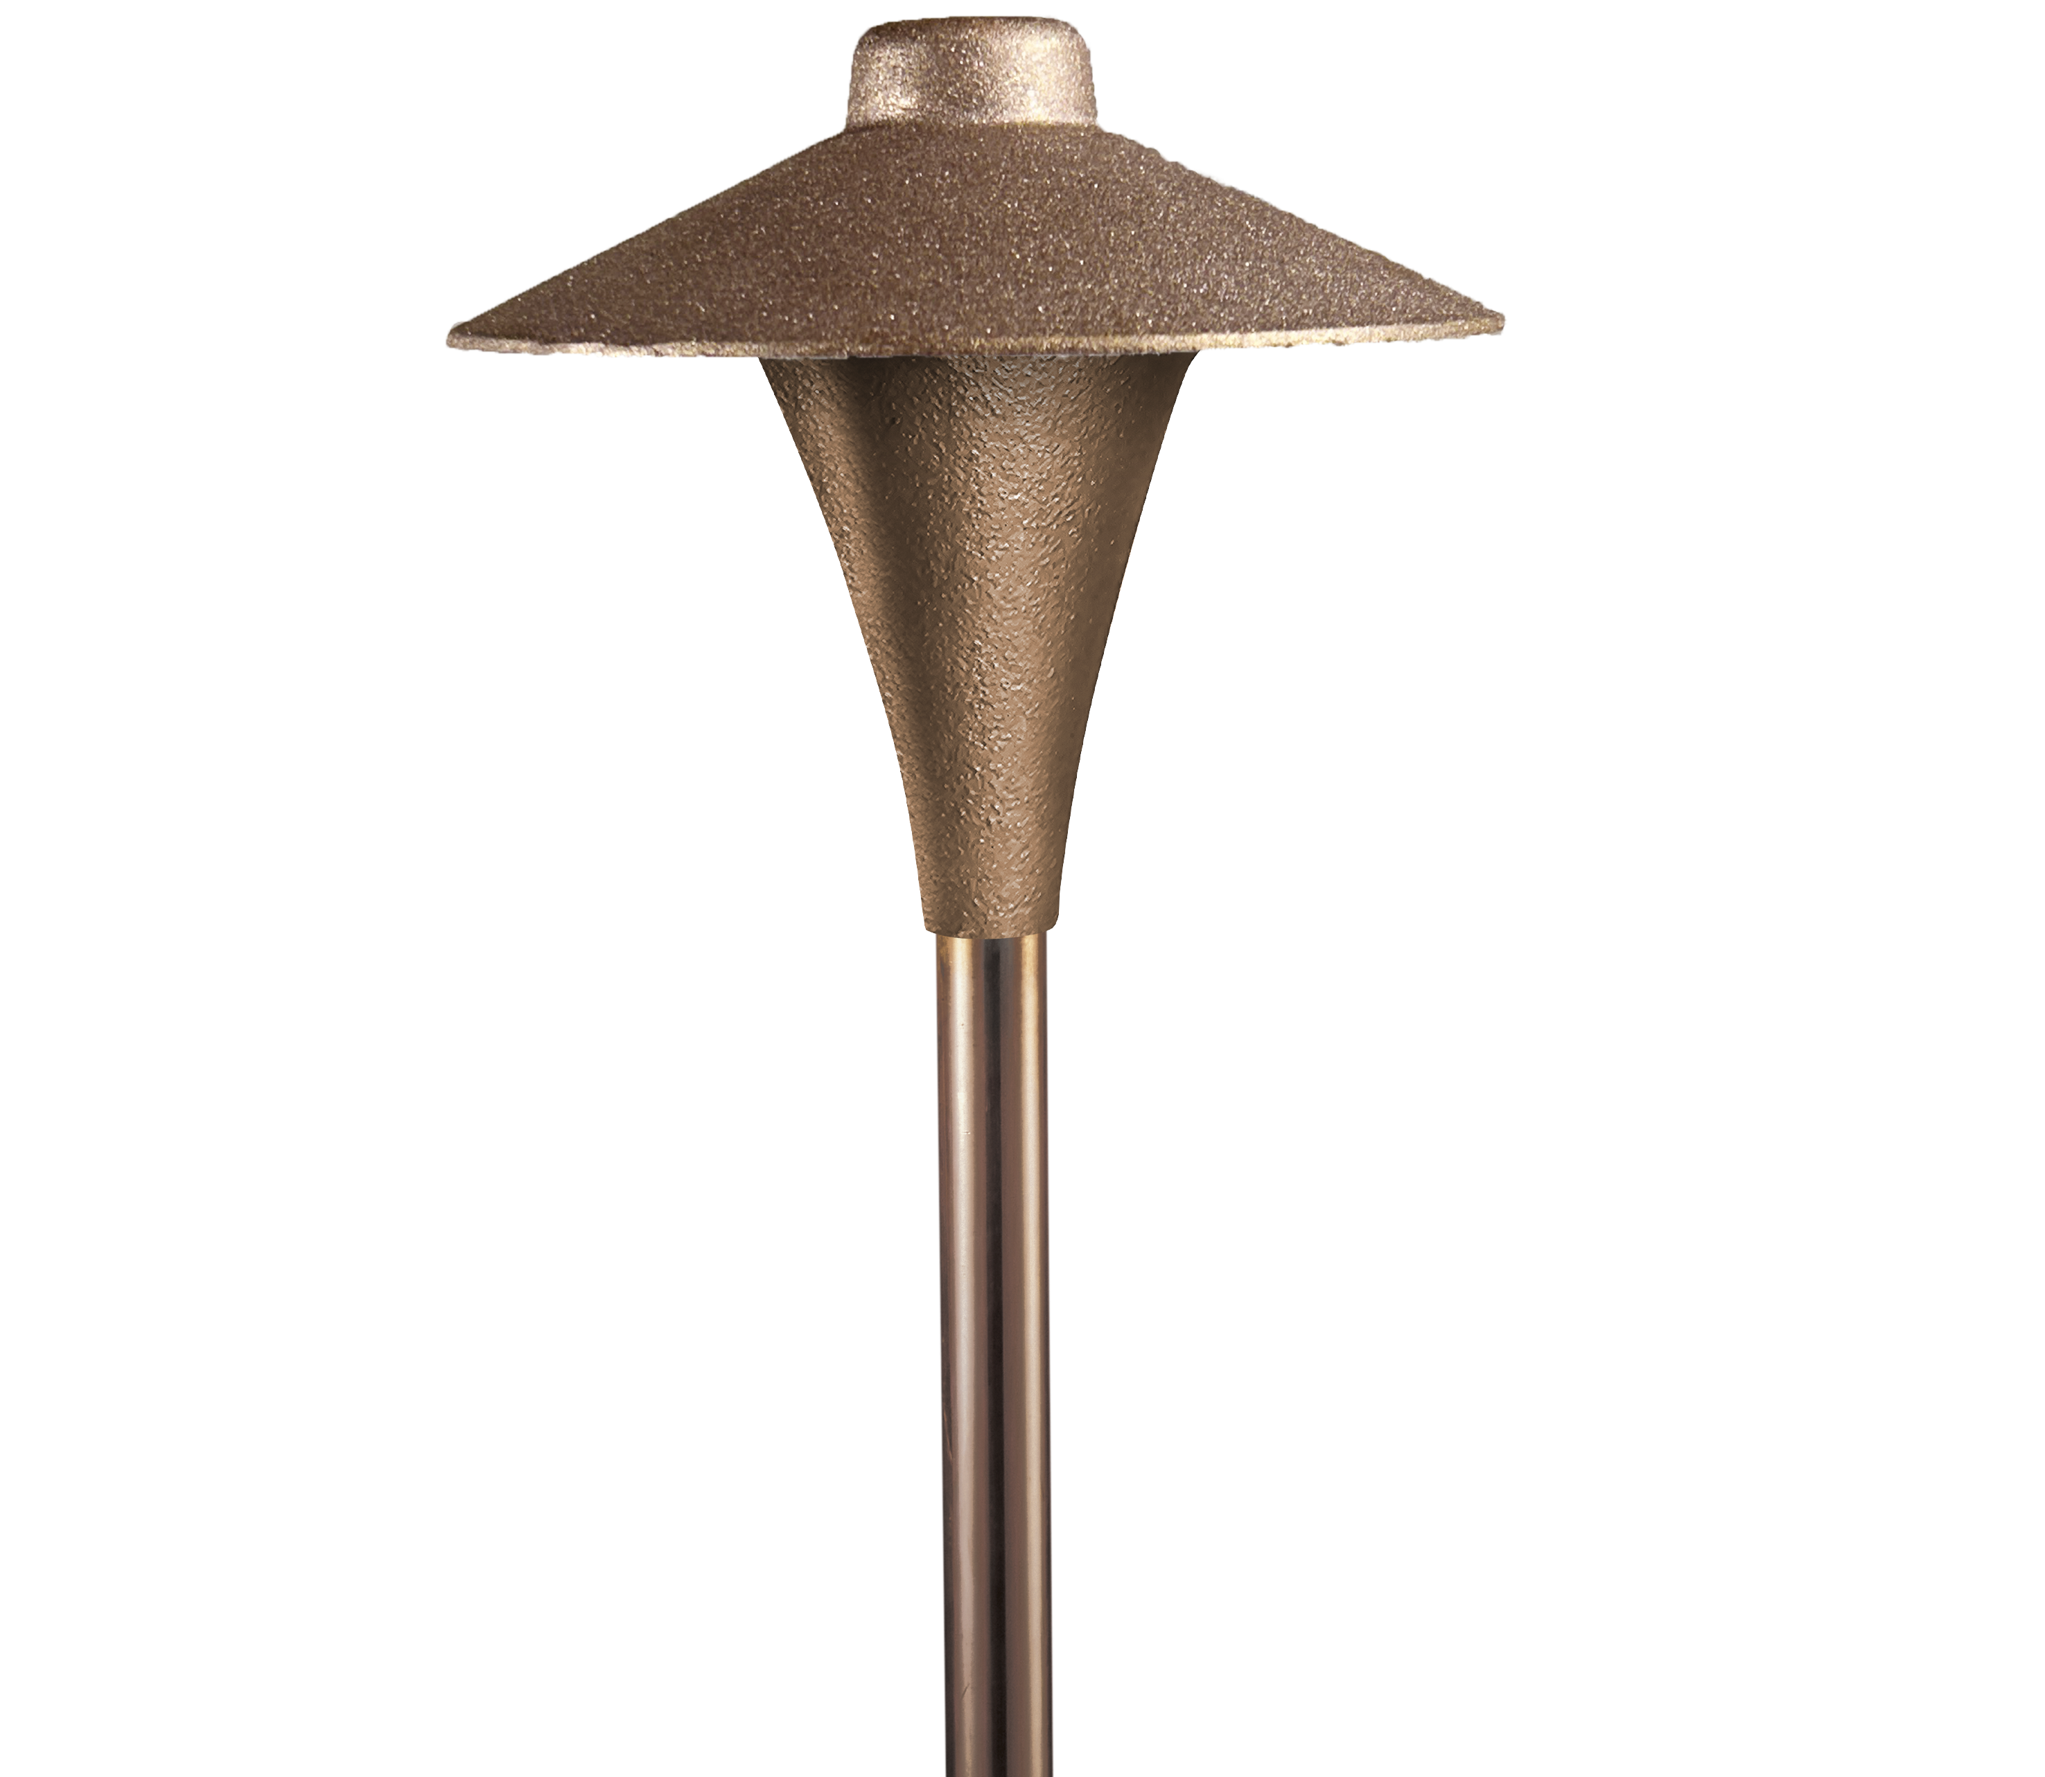
HSC-PL3
Heavy Sand-Cast Bronze
Large collar

Slide 7
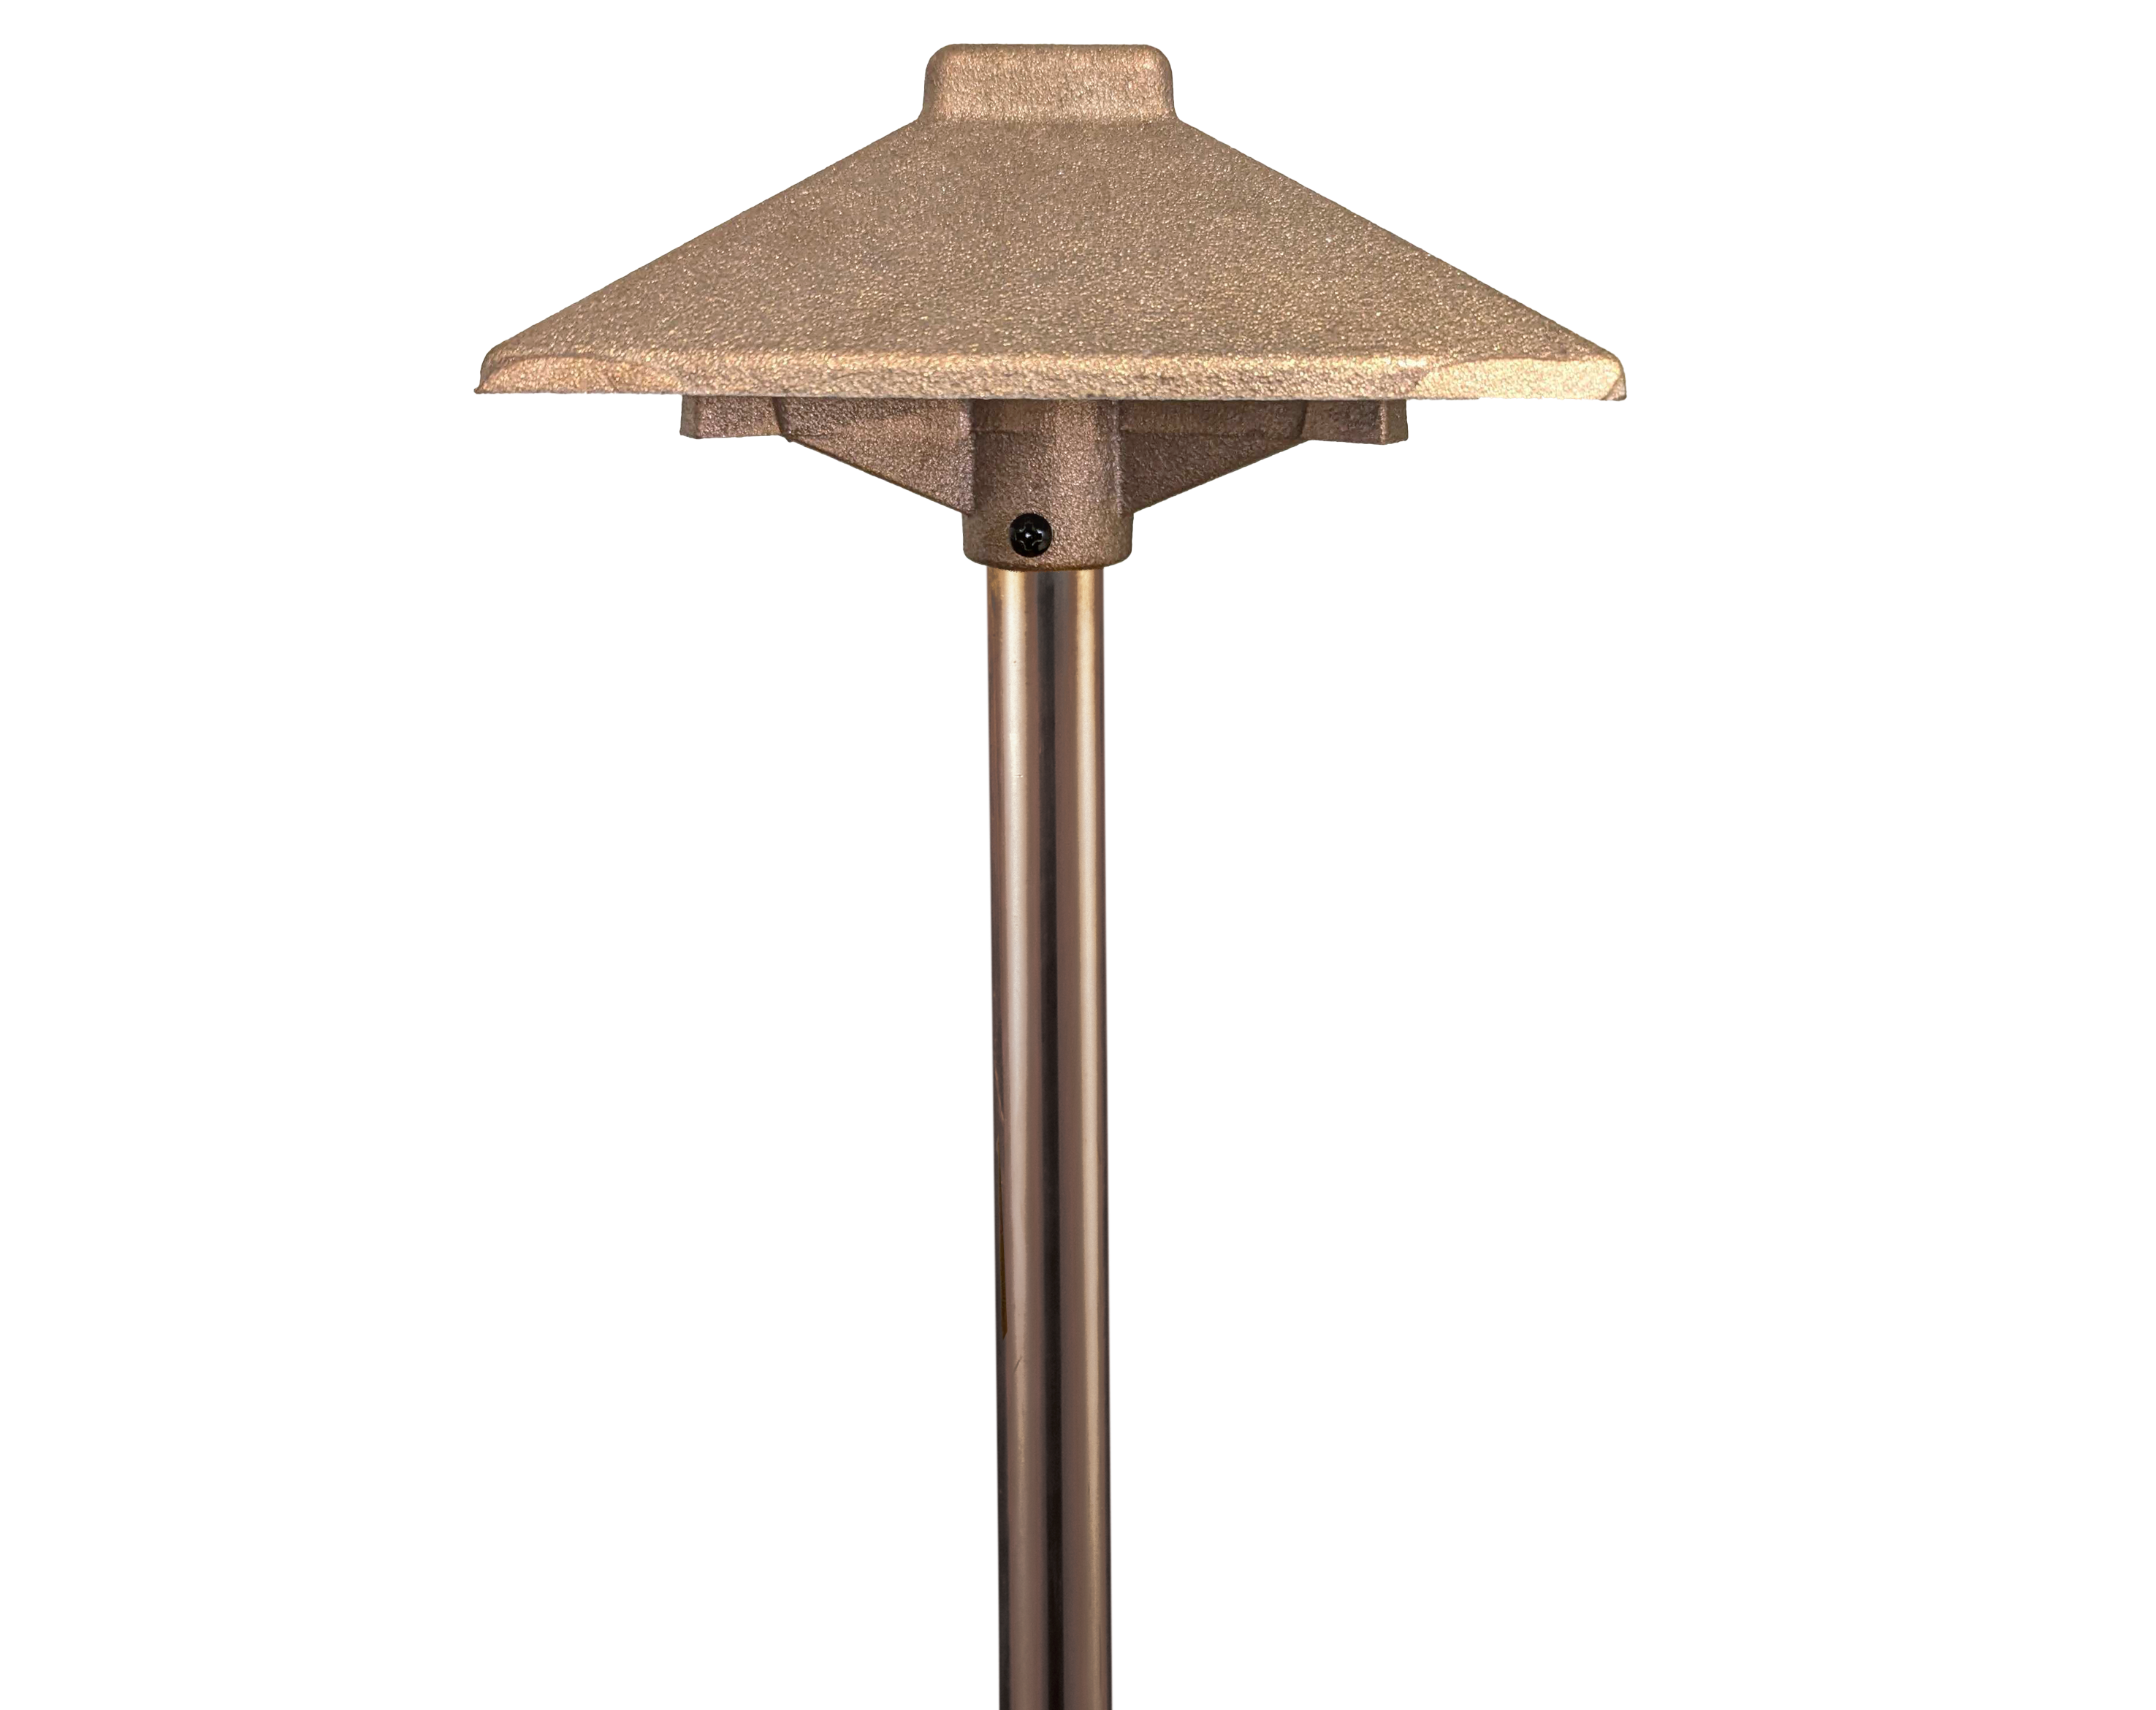
HSC-PL4
Heavy Sand-Cast Bronze
Square based hat

Slide 8
HARDSCAPE

Slide 9
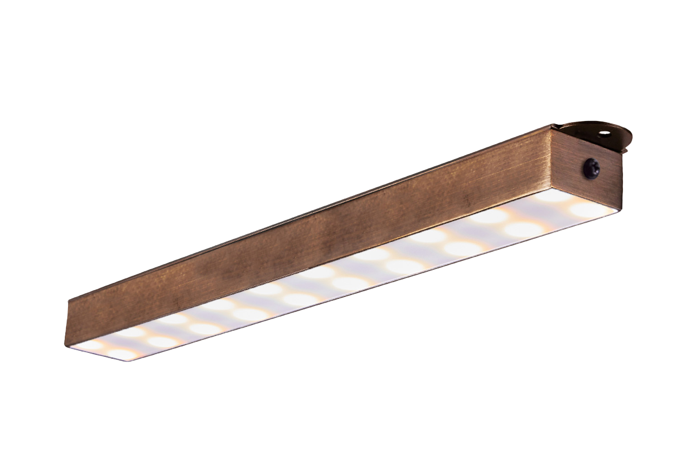
SL80-BT
Bluetooth fixture
RBGW color-changing capabilities
Dimmable white
Aged Brass Finish
Premium Black Overcoat

Slide 10
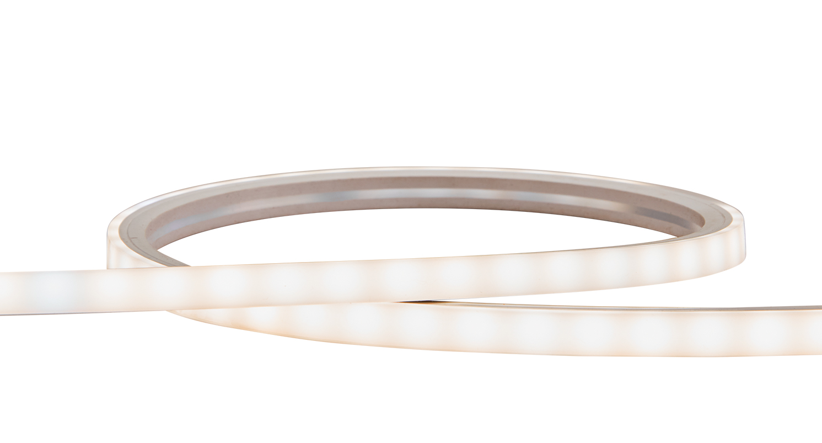
TAPE-LED
Available in 5’, 15’ and 30’
Silicone encased

Slide 11
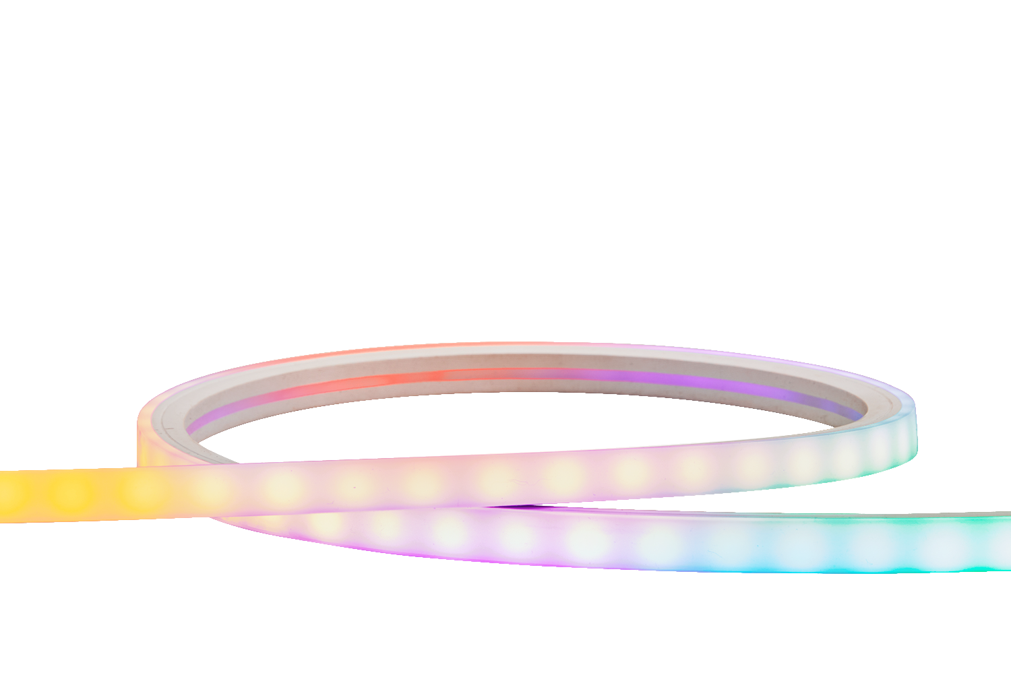
TAPE-BT
Bluetooth fixture
Available in 5’ and 15’
RBGW color-changing capabilities
Dimmable white
Silicone encased

Slide 12
MINI LIGHTS

Slide 13
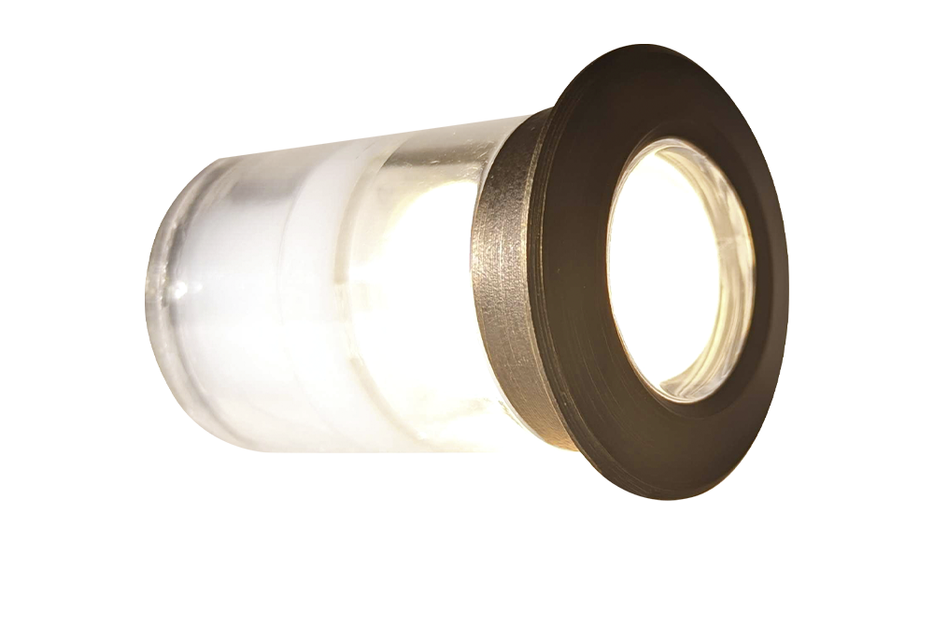
ML45-LED
Mini light
Aged Brass Finish
Premium Black Overcoat

Slide 14
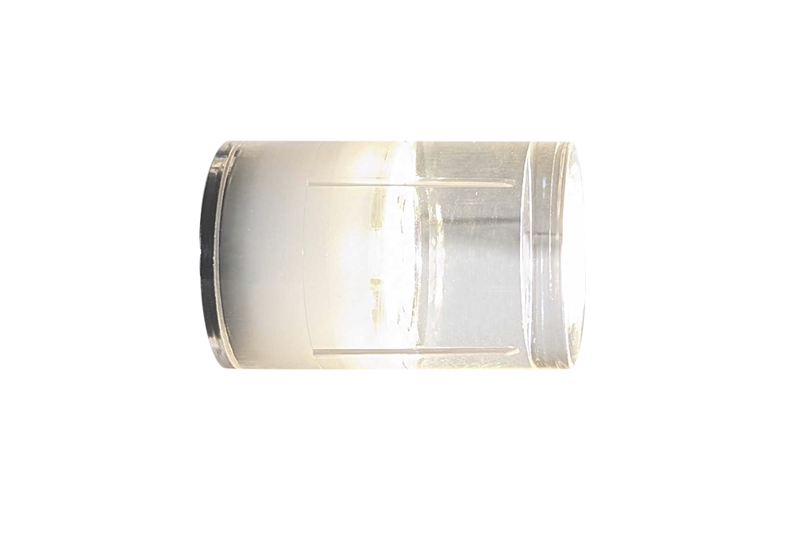
ML55-LED
Mini light

Slide 15
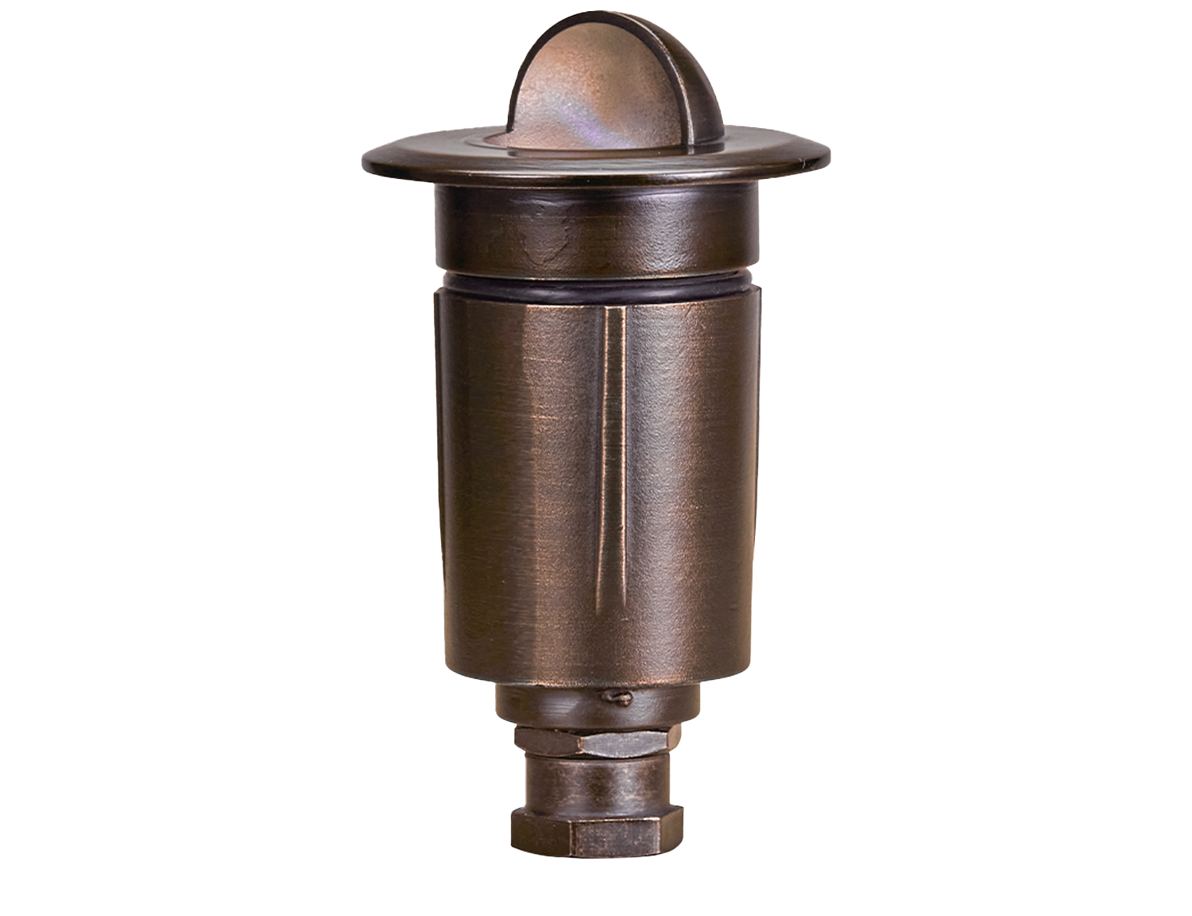
ML65
Mini light
Aged Brass Finish
Premium Black Overcoat

Slide 16
ITIMERPRO-2

Slide 17
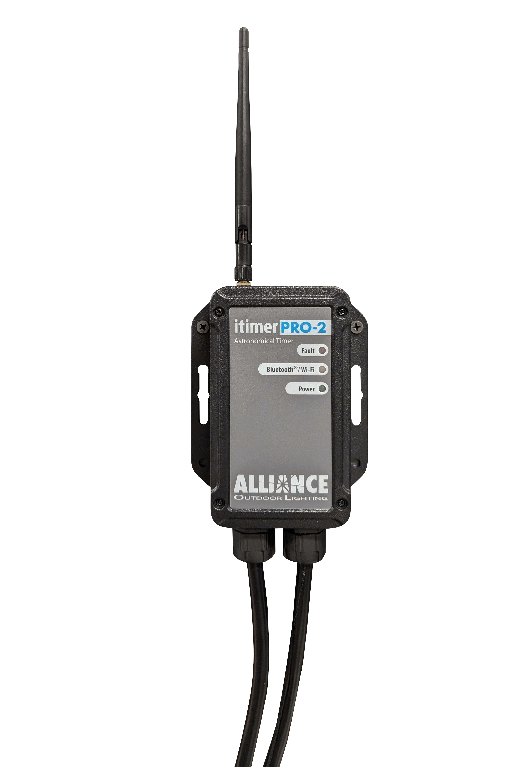
iTimerPRO-2
Astronomical timer
Connects with Bluetooth and WiFi

Slide 18
BT-ALLY-A19

Slide 19
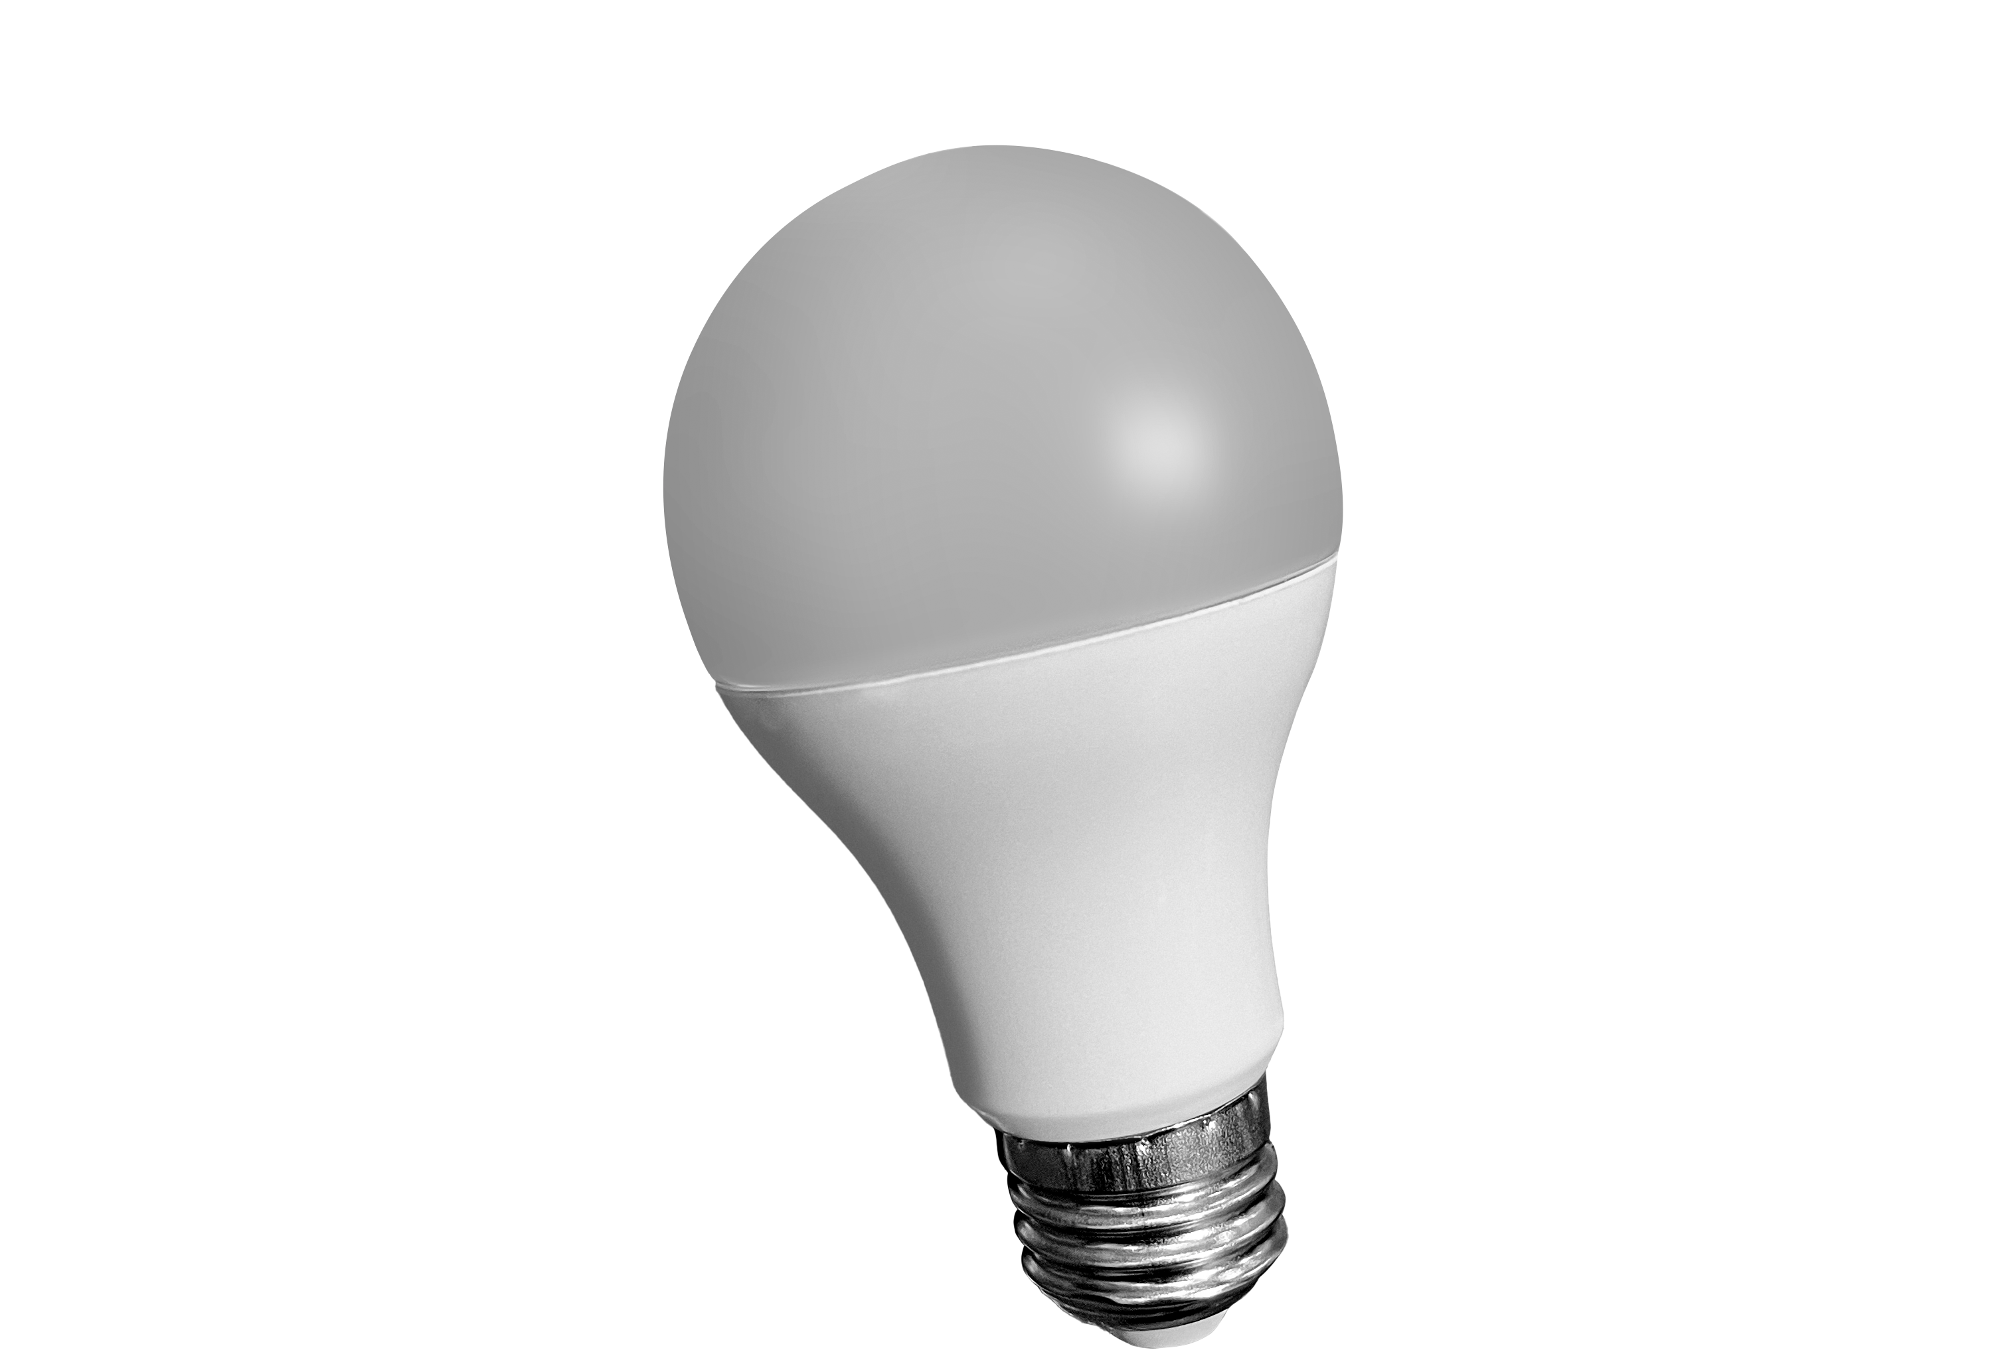
BT-ALLY-A19
Control with Bluetooth
RBGW color-changing capabilities
Dimmable white

